Slide 1

Highly available Ghost
V. Khoshghamatazad 02.15.2022

Slide 2
Requirements
Solution based on Ghost Blog platform benefiting for its unique features
Automatically adjusts capacity to maintain steady, predictable performance at the lowest possible cost
Enhanced security utilizing AWS security features
Automated deployment
V. Khoshghamatazad 02.15.2022

Slide 3
Why Ghost platform?
Ghost is an open source comes with powerful features built directly into the core software which can be customized and configured based on your needs
Ghost is heavily designed for performance thanks to its self-consuming, RESTful JSON API with decoupled admin client and front-end.
Designed for teams who need flexibility and performance.
Powerful content management as all content is stored in a standardized JSON-based document storage format called MobileDoc,
Supports for extensible rich media objects which stored sanely and fully accessible via API.
Using Admin API endpoints, you can easily manage posts, pages, and even tags using the Browse, Read, Edit, Add, Delete methods
V. Khoshghamatazad 02.15.2022
Notes:
the ability to delete all posts at once using a serverless function

Slide 4
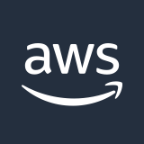




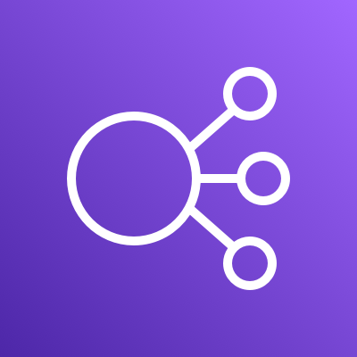

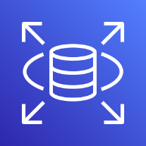



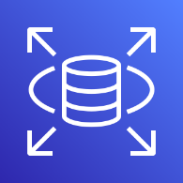
AWS Cloud
VPC
Availability Zone 1
Private subnet
Private subnet
CloudWatch
Systems Manager
Instance
RDS MySQL
ALB
CloudFront
S3
Availability Zone 2
Private subnet
Private subnet
Instance
RDS MySQL
ALB
Access to every and each resource is limited and control by Security Groups
Auto Scaling group to scale up and self heal in case of hardware failure
Multi AZ MySQL RDS
V. Khoshghamatazad 02.15.2022

Slide 5
Solution Design overview
Amazon Systems Manager and CloudWatch
enriches you with the tools to support operations, visualizing and debugging the state of the environment, receiving alerts
Explorer provides key insights and analysis into the operational health and performance of your AWS environment
OpsCenter provides a central location where operations engineers and IT professionals can view, investigate, and resolve operational issues related to AWS resources
Incident Manager, can automatically executes pre-configured response plans to engage responders via SMS and phone calls, links designated chat channels when a critical issue is detected by an Amazon CloudWatch alarm or Amazon EventBridge event
Session Manager provides a browser-based interactive shell, CLI and browser based remote desktop access for managing instances without the need to open inbound ports, manage Secure Shell (SSH) keys, or use bastion hosts. Access can be granted or revoked through a central location by using IAM policies, including the option to provide non-root access to specified users
V. Khoshghamatazad 02.15.2022

Slide 6
Solution Design overview
CloudFront, to accelerating the delivery of the static blog content (for example, images, style sheets, Videos, and so on) to viewers across the globe, and taking advantage of the edge servers to give viewers a fast, safe, and reliable experience which reduces latency and VM load
Using Application Load Balancer as our Public interface, we can place the webserver in a private subnet to increase the security by restricting access.
Amazon RDS for MySQL, helps us to benefit from auto Scaling feature to meet connectivity and workload requirements. In addition, by a multi-Region deployment solution ensures high availability of our DB
Amazon S3 bucket, brings the advantage of the flexibility, scale, security, and efficiency cloud storage that can be shared among different servers. In addition, all the static contents can be accessed directly by CloudFront which decrease latency and the load on the web/application server.
High availability, since Ghost is not supporting any kind of clustering, using a Active-Passive configuration in two different Availability Zone with self healing will help an smooth and resilient experience. In addition, step scaling will support the load increase in pick times by scaling up the VM to handle more loads.
Security, placing application and DB tier in different private subnet will decrease the security risk by not exposing them to public access.
V. Khoshghamatazad 02.15.2022

Slide 7
Solution Design overview
IaC, Infrastructure as code (e.g. Terraform, CloudFormation, Pulumi) is a key DevOps practice that is used in conjunction with continuous delivery. With the power of IaC,
We can easily spin up multiple environments for Dev, Stage and Prod.
Version controlling: Changes in the infrastructure can be easily tracked, reverted, archived, reviewed as pull requests and commits.
Reproducibility: The same infrastructure can be re-produced easily by executing the IaC templates and scripts, avoiding inconsistency issues caused by manual setups.
Documentation: IaC templates are self-documenting, omitting the need to write and update handbooks and wikis.
IaC integrate into CI/CD pipeline: Continuously test and deploy IaC templates as part of the CI/CD pipelines which minimize the maintenance and development efforts as well.
V. Khoshghamatazad 02.15.2022

Slide 8
Solution Design overview
Releasing new versions of the application, can be handled easily without requiring any downtime by using deployment techniques like Blue-green deployment.
Blue-green deployment can reduce downtime and risk by running two identical production environments called Blue and Green (active-passive). As you prepare a new version of your software, deployment and the final stage of testing takes place in the environment that is not live:
in this example, Green. Once you have deployed and fully tested the software in Green, all incoming requests can be switch to Green instead of Blue. Green is now live, and Blue is idle.
V. Khoshghamatazad 02.15.2022

Slide 9
Continuous Integration & Continuous Deployment
AWS Development Kit, help us building a CI/CD pipeline, where new code is submitted on one end, tested over a series of stages (source, build, test, staging, and production), and then published as production-ready code.
V. Khoshghamatazad 02.15.2022

Slide 10
Alternative solution
(Cost effective)
AWS Cloud
VPC
Availability Zone 1
Private subnet
Private subnet
CloudWatch
Systems Manager
Instance
ALB
RDS MySQL
Availability Zone 2
CloudFront
Private subnet
S3
Instance (stopped)
Auto Scaling group to self heal in case of hardware failure
Access to every and each resource is limited and control by Security Groups
There would be a downtime until the stopped instance is up and running.
In addition, we need to deploy separately to both instance.
V. Khoshghamatazad 02.15.2022

Slide 11
Alternative Solutions
AWS Beanstalk
Doing custom config is hard, especially creating a custom httpd.conf for your app
I find it a bit harder to give access to Beanstalk to 3rd parties. For beanstalk, you have to figure out IAM roles and get them to install the beanstalk CLI client.
Docker
The Docker image for Ghost is an unofficial community package maintained by people within the Ghost developer community.
V. Khoshghamatazad 02.15.2022

